Slide 1
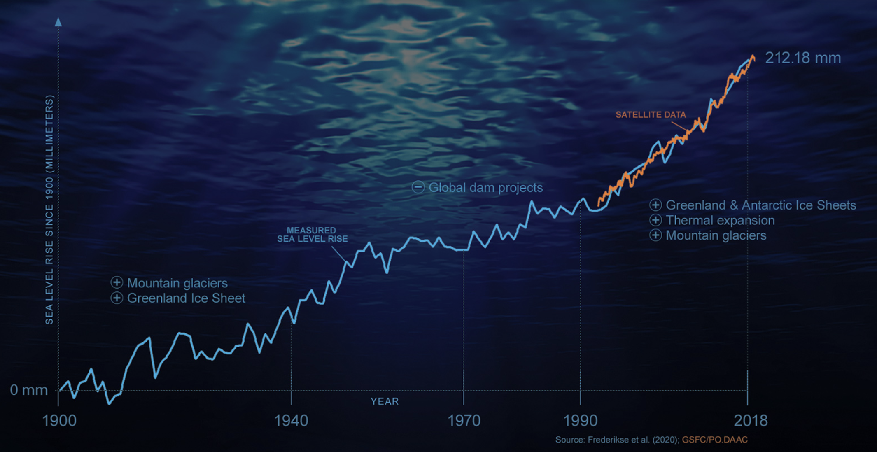
Thermodynamics and global sea level rise
https://climate.nasa.gov/news/3012/nasa-led-study-reveals-the-causes-of-sea-level-rise-since-1900/
What does thermodynamics have to say about this?

Slide 2
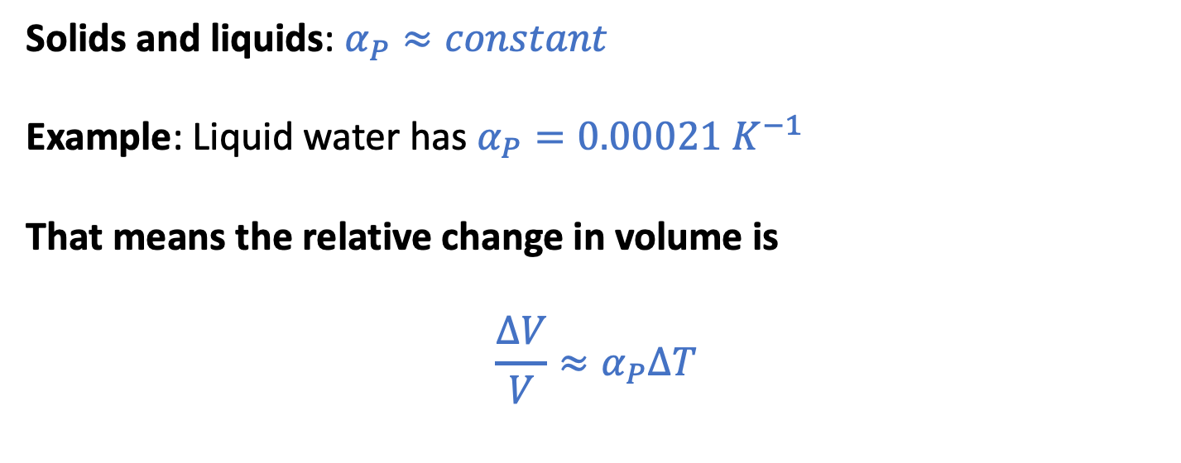


The “Isobaric thermal expansivity”
$$α_{P}≡\frac{1}{V}{\left(\frac{∂V}{∂T}\right)}_{P}$$
$$∆V$$
Solids and liquids: $α_{P}≈constant$
Example: Liquid water has $α_{P}=0.00021{ K}^{−1}$
That means the relative change in volume is
$${\frac{∆V}{V}≈α}_{P}∆T$$
$$V$$

Slide 3



The “Isobaric thermal expansivity”
$$α_{P}≡\frac{1}{V}{\left(\frac{∂V}{∂T}\right)}_{P}$$
For a given column of water, this means
$${\frac{∆h}{h}≈α}_{P}∆T$$
or
$$∆h {≈h α}_{P}∆T$$
$$∆h$$
$$h$$

Slide 4
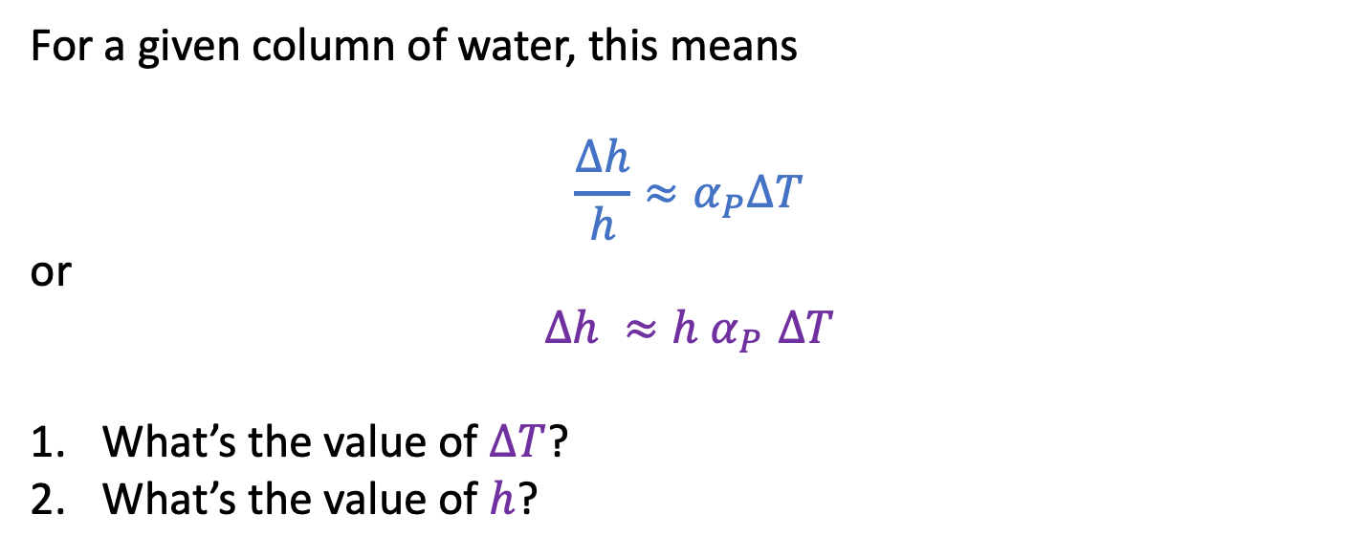
The “Isobaric thermal expansivity”
$$α_{P}≡\frac{1}{V}{\left(\frac{∂V}{∂T}\right)}_{P}$$
For a given column of water, this means
$${\frac{∆h}{h}≈α}_{P}∆T$$
or
$$∆h {≈h α}_{P}∆T$$
What’s the value of $∆T$?
What’s the value of $h$?
$$∆h$$
$$h$$

Slide 5
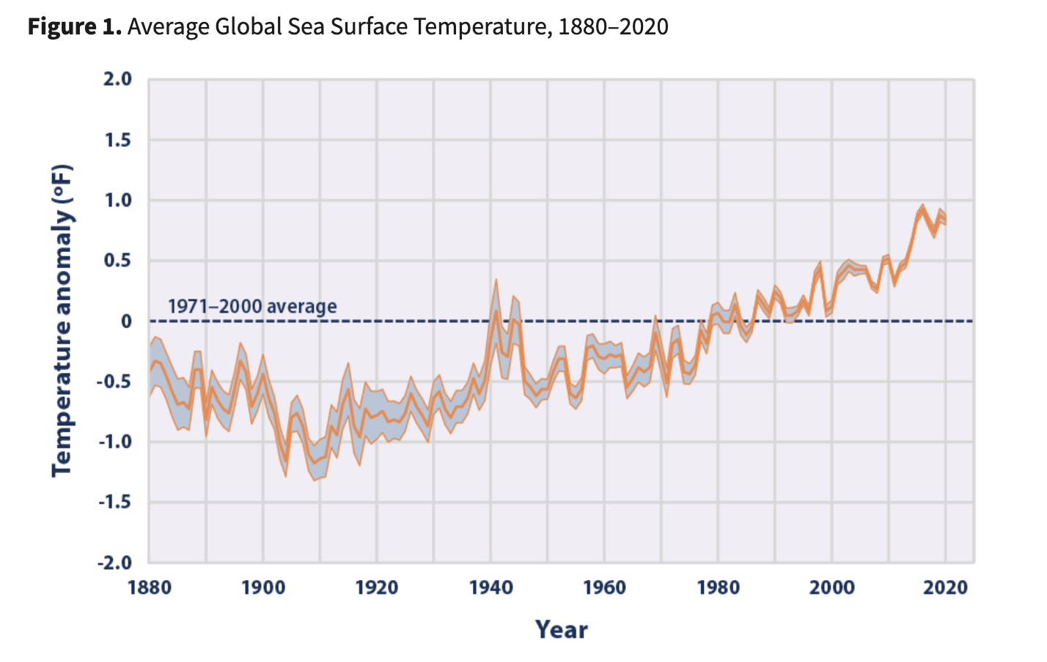


Global sea surface temperature, 1880-2020
$$∆T= 1.5 ℉= 0.8 K$$
Looks like $∆T$ for the ocean surface is $\sim 0.8 K$
https://www.epa.gov/climate-indicators/climate-change-indicators-sea-surface-temperature

Slide 6
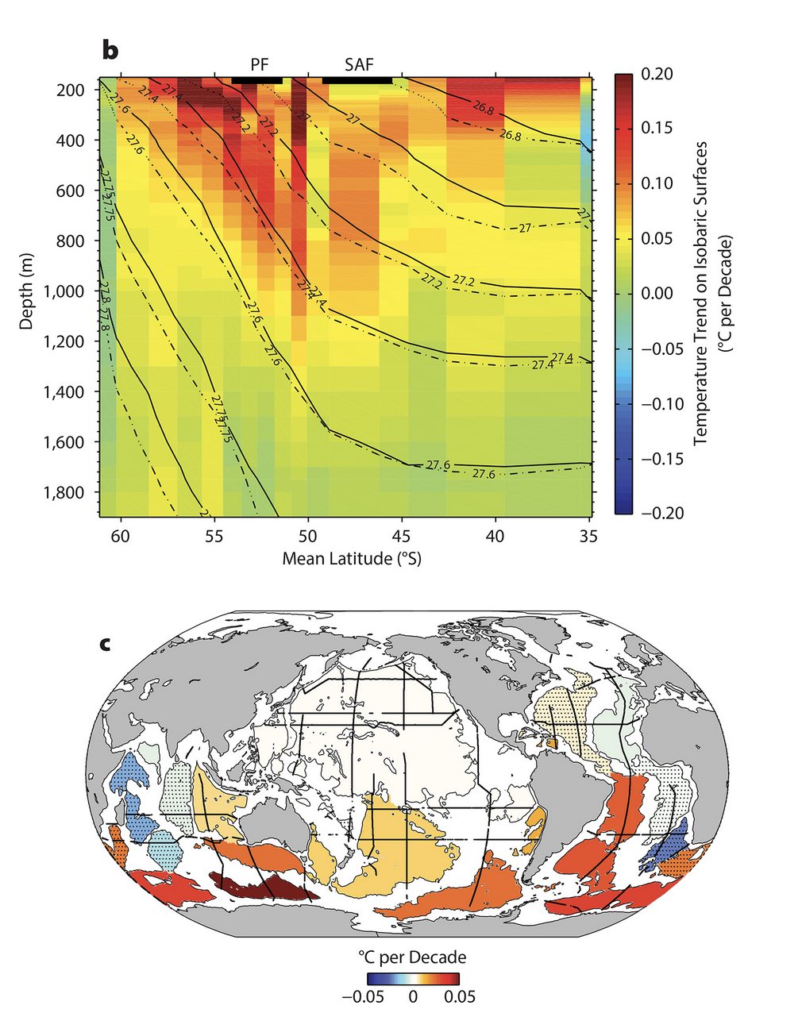

Depth of the warming (Southern Ocean)
Looks like $h$ for the ocean is $\sim 1000 m$
(we’d have to do an integration to get this right)
https://tos.org/oceanography/article/southern-ocean-warming

Slide 7
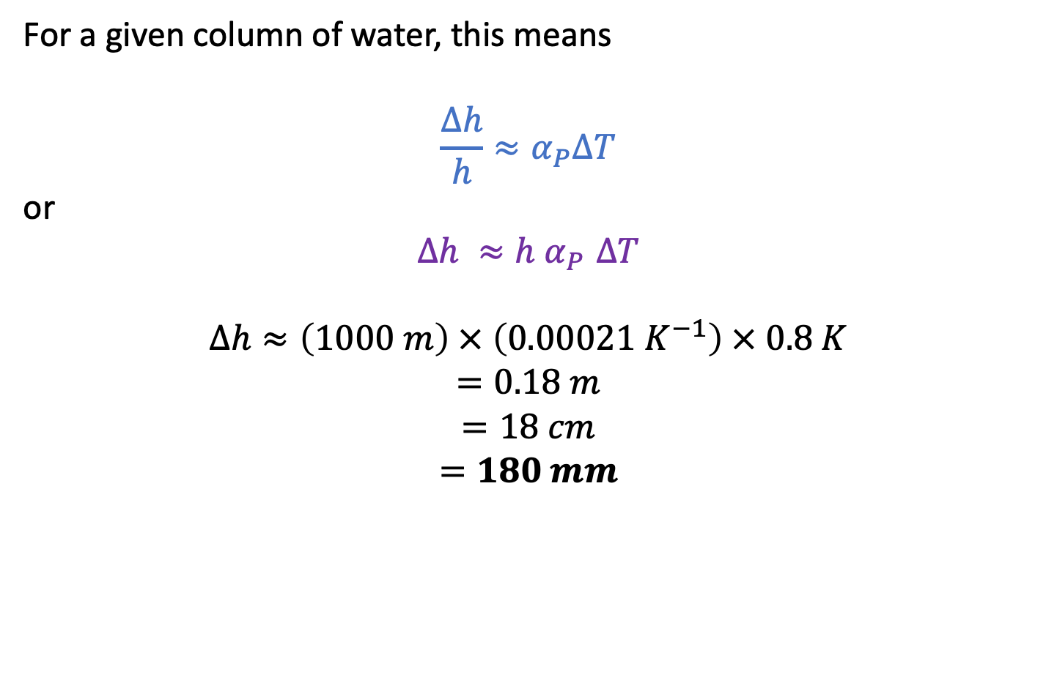
Predicting sea level rise due to thermal expansion
$$α_{P}≡\frac{1}{V}{\left(\frac{∂V}{∂T}\right)}_{P}$$
For a given column of water, this means
$${\frac{∆h}{h}≈α}_{P}∆T$$
or
$$∆h {≈h α}_{P}∆T$$
$$∆h≈\left(1000 m\right) × \left(0.00021{ K}^{−1}\right) × 0.8 K$$
$$=0.18 m$$
$$=18 cm$$
$$=180 mm$$
$$∆h$$
$$h$$

Slide 8

Other contributors to sea level rise
Thermal contribution = $180 mm$
So … Thermal expansion could account for $\sim 80\%$ of the observed sea level rise so far.

Slide 9
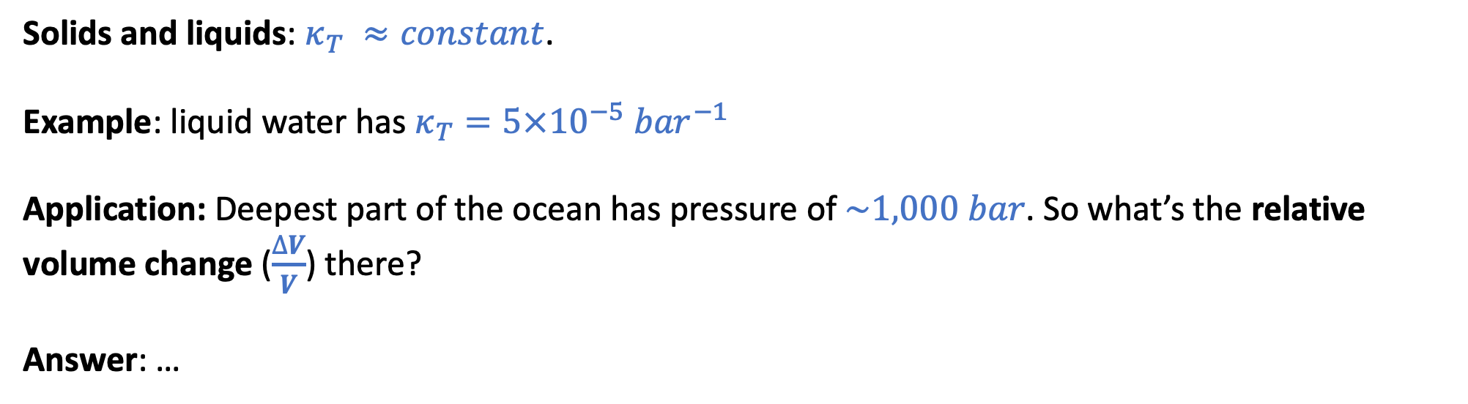
The “Isothermal compressibility”
$κ_{T}≡−\frac{1}{V}{\left(\frac{∂V}{∂P}\right)}_{T}$ … for small changes in temperature, we can say $\frac{∆V}{V}≈{−κ}_{T}∆P$
Solids and liquids: $κ_{T} ≈constant$.
Example: liquid water has $κ_{T}=5×10^{−5}{ bar}^{−1}$
Application: Deepest part of the ocean has pressure of $\sim 1,000 bar$. So what’s the relative volume change ($\frac{∆V}{V}$) there?
Answer: …

Slide 10
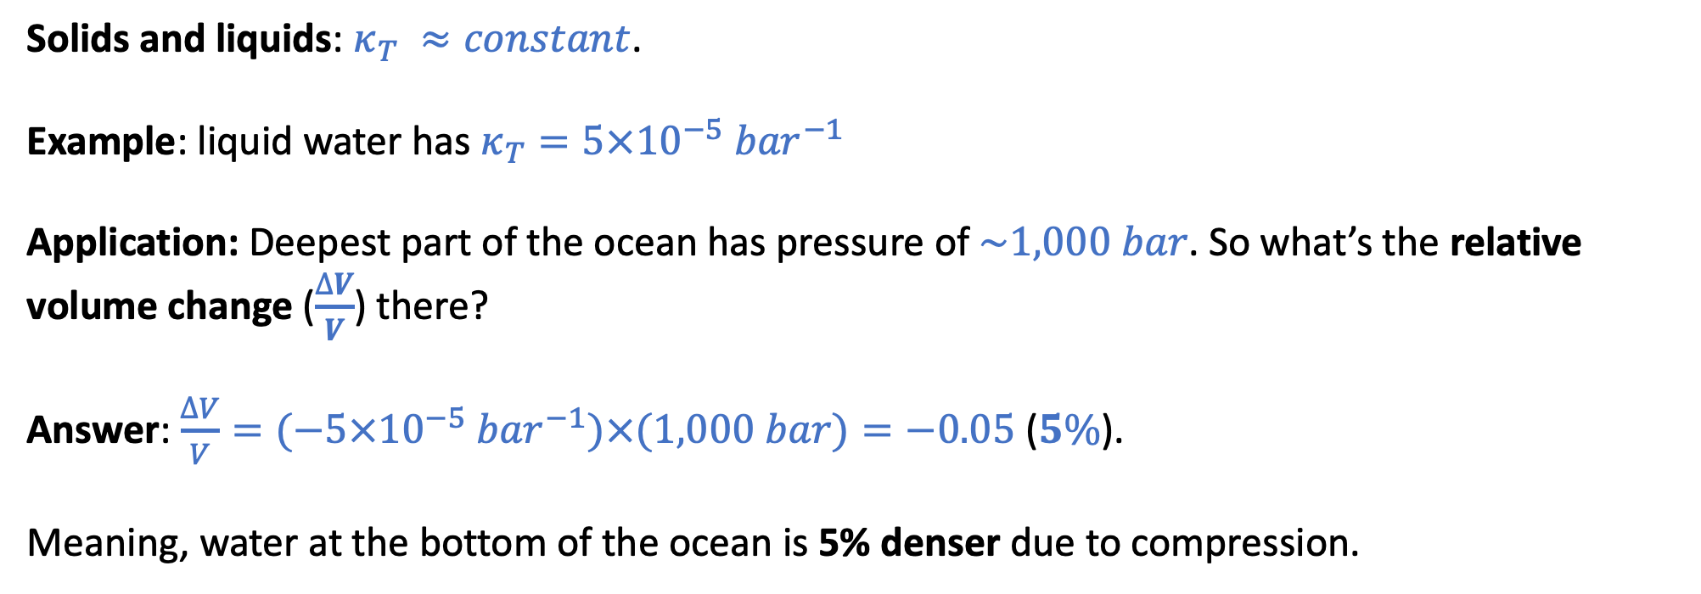
The “Isothermal compressibility”
$κ_{T}≡−\frac{1}{V}{\left(\frac{∂V}{∂P}\right)}_{T}$ … for small changes in temperature, we can say $\frac{∆V}{V}≈{−κ}_{T}∆P$
Solids and liquids: $κ_{T} ≈constant$.
Example: liquid water has $κ_{T}=5×10^{−5}{ bar}^{−1}$
Application: Deepest part of the ocean has pressure of $\sim 1,000 bar$. So what’s the relative volume change ($\frac{∆V}{V}$) there?
Answer: $\frac{∆V}{V}=(−5×10^{−5}{ bar}^{−1})×(1,000 bar)=−0.05$ ($5\%$).
Meaning, water at the bottom of the ocean is 5% denser due to compression.

Slide 11
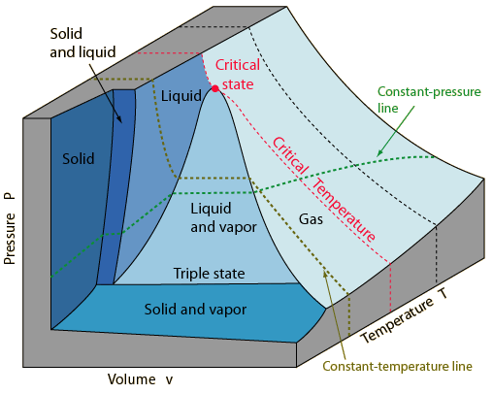
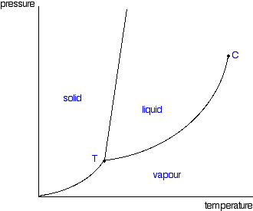


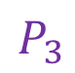
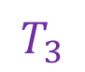
Phase diagrams
$$P_{3}$$
$$T_{3}$$
$$T_{crit}$$
This is a typical phase diagram
The lines are called phase boundaries.
We’ve already talked about $T_{crit}$ and $P_{crit}$.
The triple-point temperature and pressure are called $T_{3}$ and $P_{3}$.

Slide 12
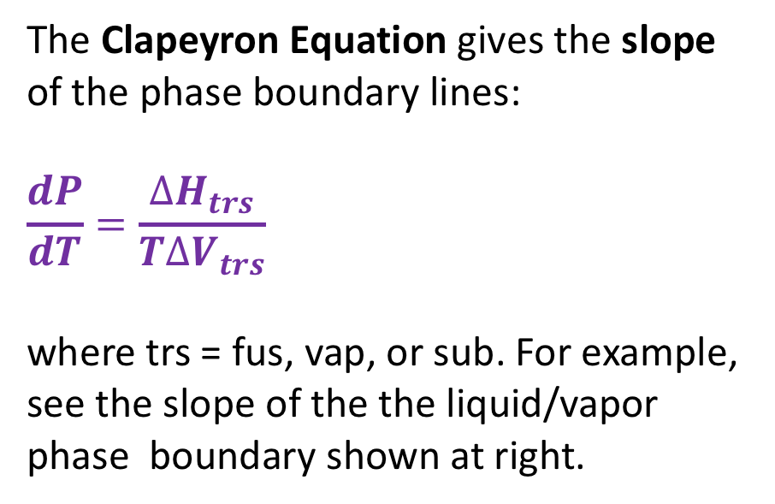
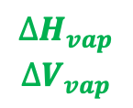
Clapeyron equation
The Clapeyron Equation gives the slope of the phase boundary lines:
$$\frac{dP}{dT}=\frac{∆H_{trs}}{T∆V_{trs}}$$
where trs = fus, vap, or sub. For example, see the slope of the the liquid/vapor phase boundary shown at right.
$$∆H_{vap}$$
$$∆V_{vap}$$
We’ll derive this equation later. For now we’ll just use it to obtain expressions for the phase boundary lines themselves – by integrating the slope.

Slide 13
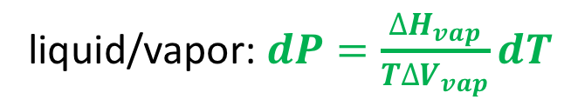
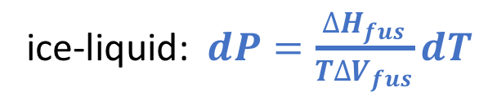
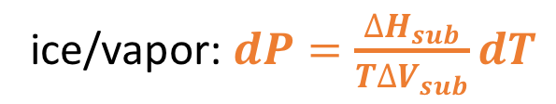
Integrating the Clapeyron Equation
It makes sense to start integration at the triple point because we know $T_{3}$ and $P_{3}$ very accurately
ice-liquid: $dP=\frac{∆H_{fus}}{T∆V_{fus}}dT$
P
liquid/vapor: $dP=\frac{∆H_{vap}}{T∆V_{vap}}dT$
T
ice/vapor: $dP=\frac{∆H_{sub}}{T∆V_{sub}}dT$

Slide 14
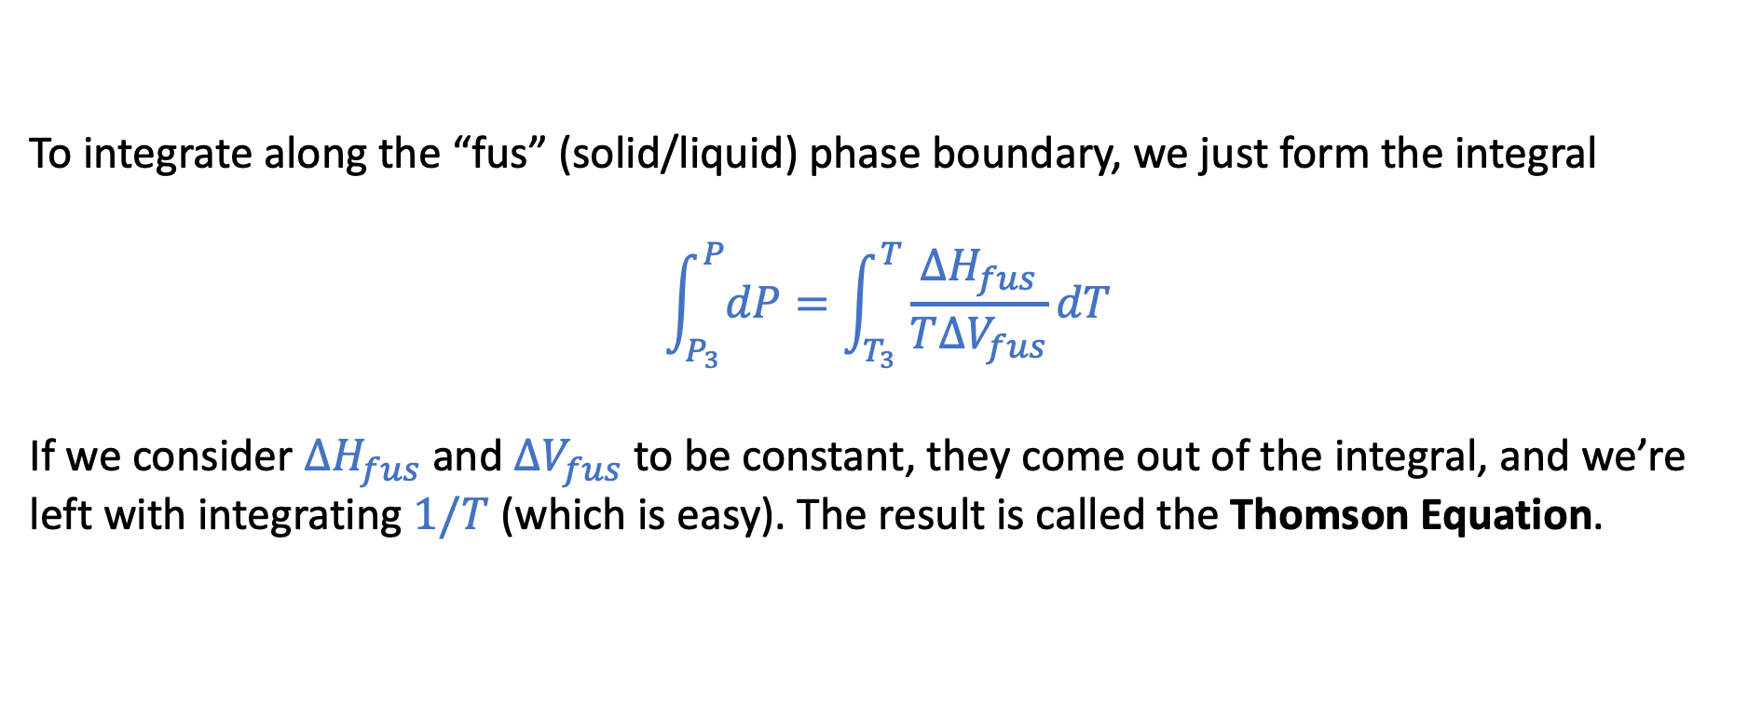
Solid/liquid phase boundary
P
T
To integrate along the “fus” (solid/liquid) phase boundary, we just form the integral
$$\int_{P_{3}}^{P}{dP}=\int_{T_{3}}^{T}{\frac{∆H_{fus}}{T∆V_{fus}}dT}$$
If we consider $∆H_{fus}$ and $∆V_{fus}$ to be constant, they come out of the integral, and we’re left with integrating $1/T$ (which is easy). The result is called the Thomson Equation.

Slide 15

Liquid/vapor phase boundary
P
T
For the liquid/vapor boundary, we still start with Clapeyron, $dP=\frac{∆H_{vap}}{T∆V_{vap}}dT$. But there’s a problem: $∆V_{vap}$ and $∆H_{vap}$ are not at constant along this curve, so it can’t come out of the integral like before!

Slide 16
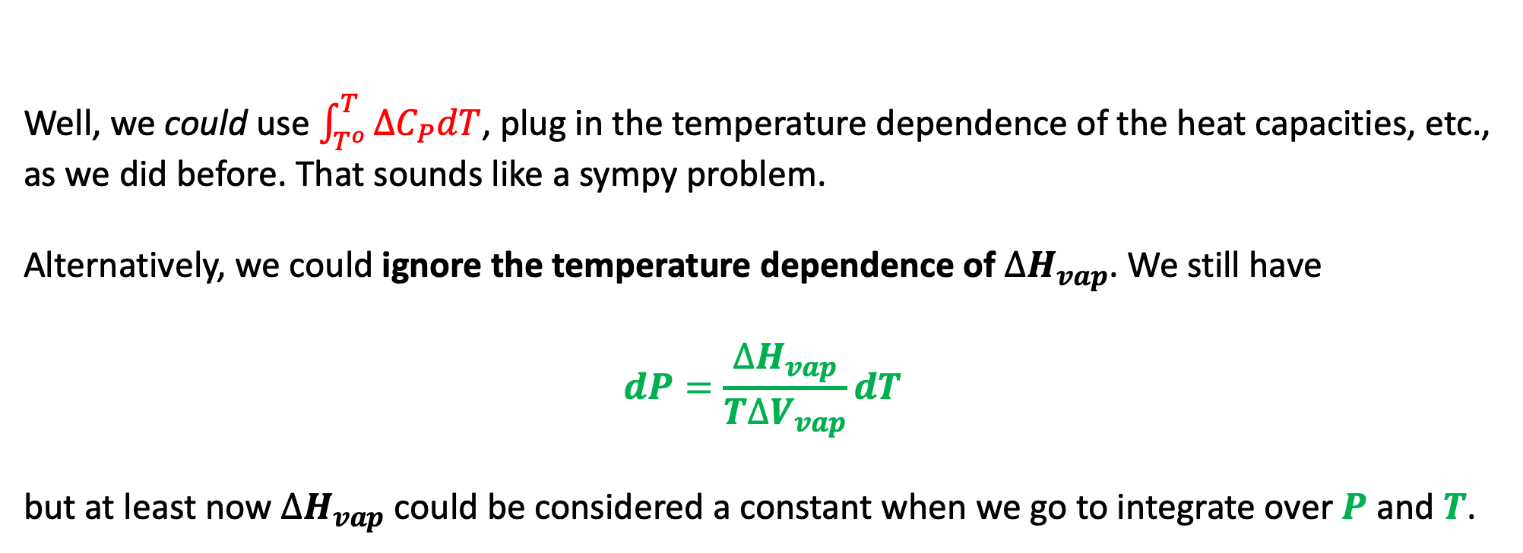
What to do about $∆H_{vap}$ along a liquid-vapor phase boundary …
Well, we could use $\int_{T^{o}}^{T}{{∆C}_{P}dT}$, plug in the temperature dependence of the heat capacities, etc., as we did before. That sounds like a sympy problem.
Alternatively, we could ignore the temperature dependence of $∆H_{vap}$. We still have
$$dP=\frac{∆H_{vap}}{T∆V_{vap}}dT$$
but at least now $∆H_{vap}$ could be considered a constant when we go to integrate over $P$ and $T$.

Slide 17
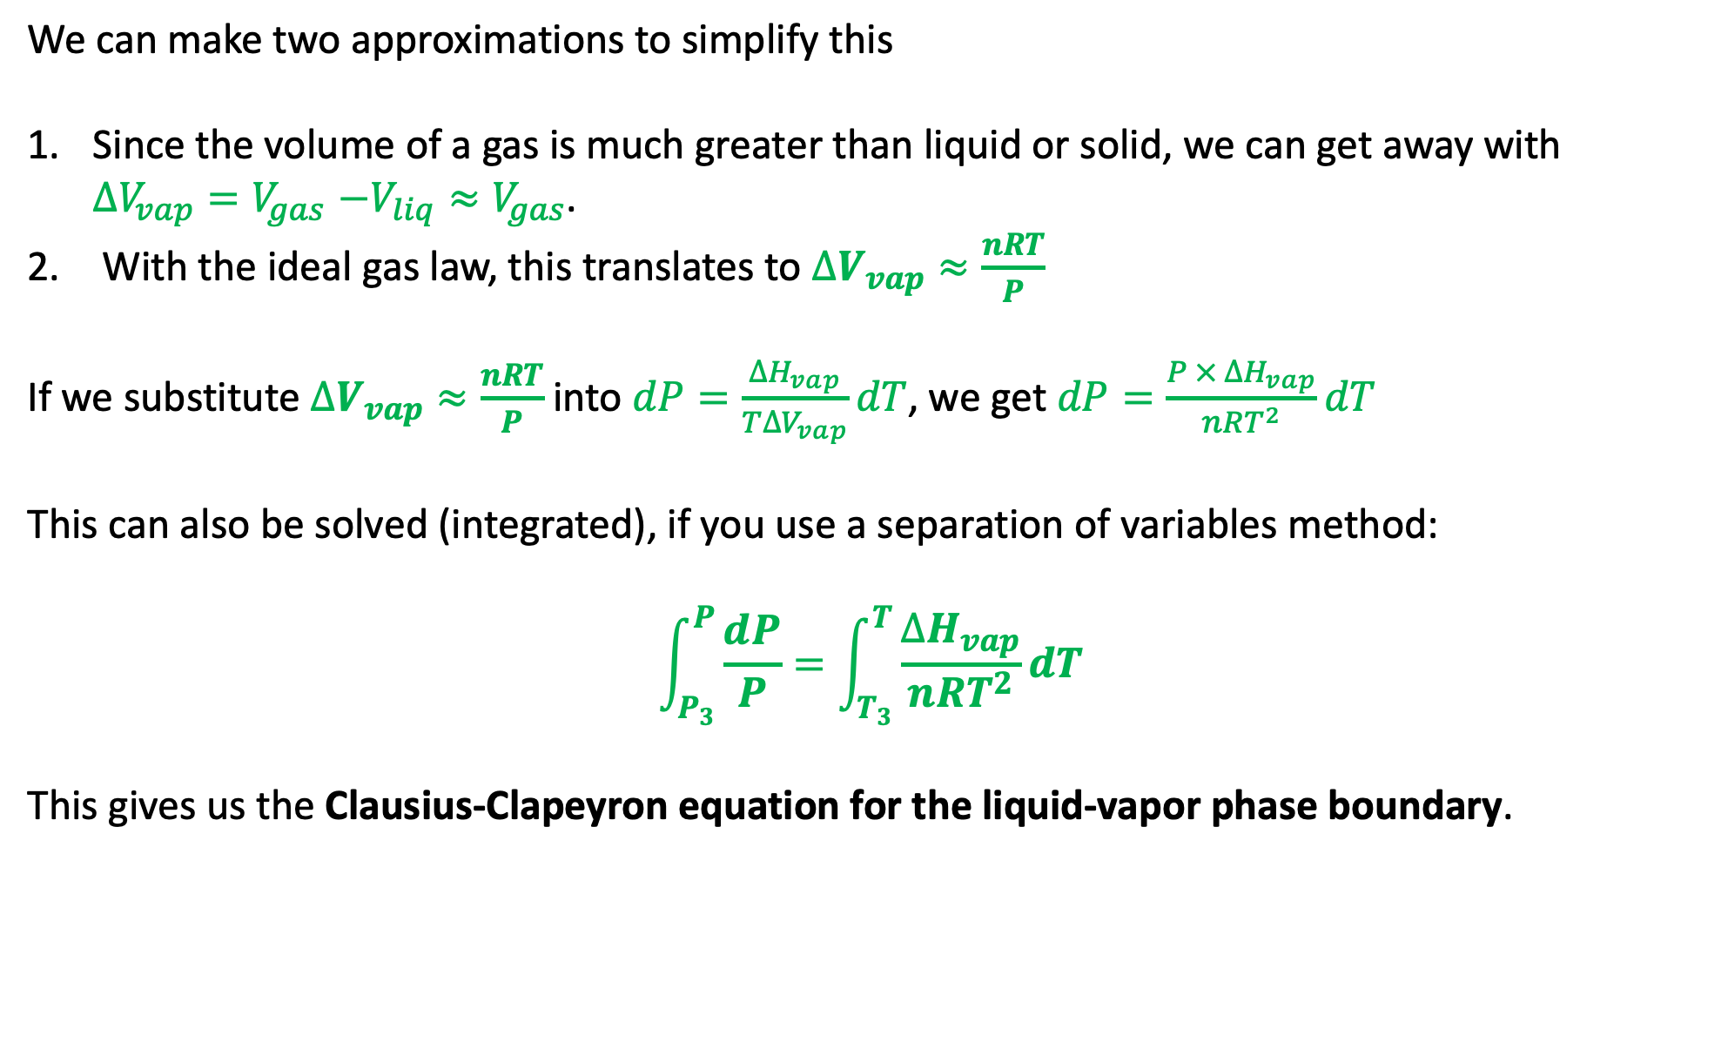
What to do about $∆V_{vap}$ along a liquid-vapor phase boundary …
We can make two approximations to simplify this
Since the volume of a gas is much greater than liquid or solid, we can get away with $∆V_{vap}{=V}_{gas}−V_{liq}≈V_{gas}$.
With the ideal gas law, this translates to $∆V_{vap}≈\frac{nRT}{P}$
If we substitute $∆V_{vap}≈\frac{nRT}{P}$ into $dP=\frac{∆H_{vap}}{T∆V_{vap}}dT$, we get $dP=\frac{P × ∆H_{vap}}{nRT^{2}}dT$
This can also be solved (integrated), if you use a separation of variables method:
$$\int_{P_{3}}^{P}{\frac{dP}{P}}=\int_{T_{3}}^{T}{\frac{∆H_{vap}}{nRT^{2}}dT}$$
This gives us the Clausius-Clapeyron equation for the liquid-vapor phase boundary.

Slide 18
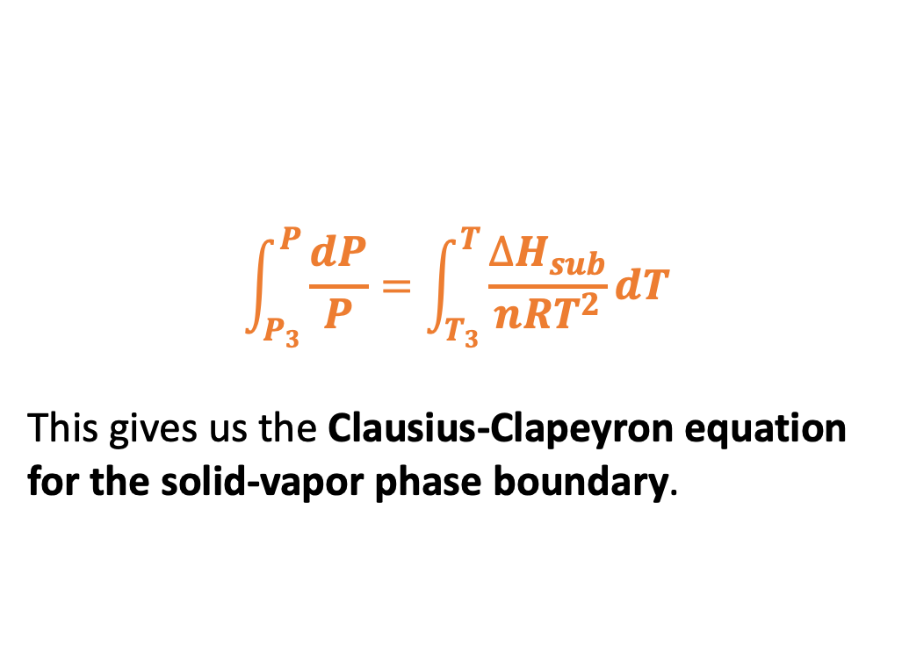
Solid/vapor phase boundary
P
T
For the solid/vapor boundary, all the same considerations apply as to liquid/vapor, so
$$\int_{P_{3}}^{P}{\frac{dP}{P}}=\int_{T_{3}}^{T}{\frac{∆H_{sub}}{nRT^{2}}dT}$$
This gives us the Clausius-Clapeyron equation for the solid-vapor phase boundary.

Slide 19
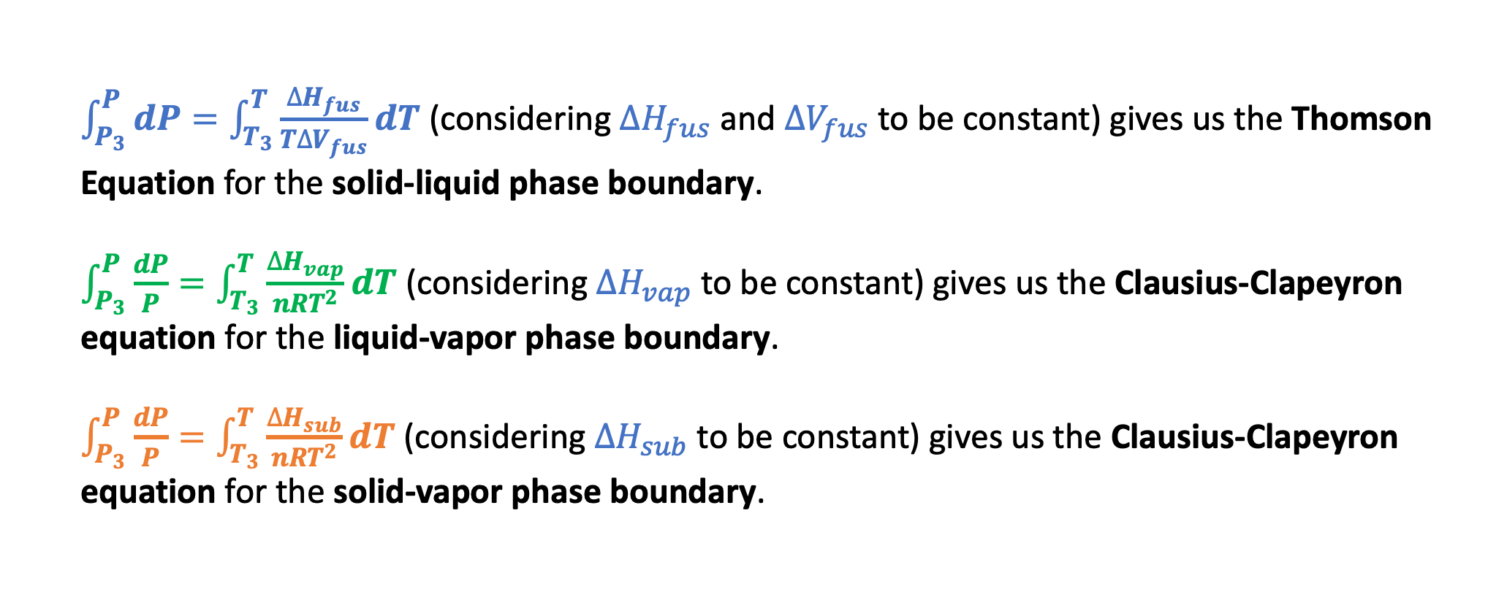
Our tasks:
$\int_{P_{3}}^{P}{dP}=\int_{T_{3}}^{T}{\frac{∆H_{fus}}{T∆V_{fus}}dT}$ (considering $∆H_{fus}$ and $∆V_{fus}$ to be constant) gives us the Thomson Equation for the solid-liquid phase boundary.
$\int_{P_{3}}^{P}{\frac{dP}{P}}=\int_{T_{3}}^{T}{\frac{∆H_{vap}}{nRT^{2}}dT}$ (considering $∆H_{vap}$ to be constant) gives us the Clausius-Clapeyron equation for the liquid-vapor phase boundary.
$\int_{P_{3}}^{P}{\frac{dP}{P}}=\int_{T_{3}}^{T}{\frac{∆H_{sub}}{nRT^{2}}dT}$ (considering $∆H_{sub}$ to be constant) gives us the Clausius-Clapeyron equation for the solid-vapor phase boundary.

Slide 20
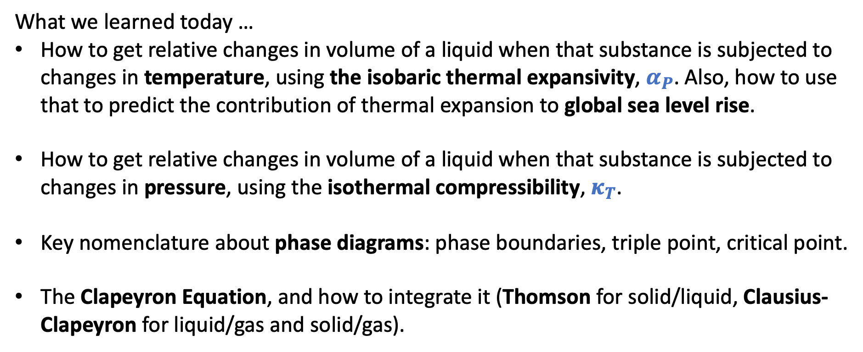
Summary
What we learned today …
How to get relative changes in volume of a liquid when that substance is subjected to changes in temperature, using the isobaric thermal expansivity, $α_{P}$. Also, how to use that to predict the contribution of thermal expansion to global sea level rise.
How to get relative changes in volume of a liquid when that substance is subjected to changes in pressure, using the isothermal compressibility, $κ_{T}$.
Key nomenclature about phase diagrams: phase boundaries, triple point, critical point.
The Clapeyron Equation, and how to integrate it (Thomson for solid/liquid, Clausius-Clapeyron for liquid/gas and solid/gas).

